Slide 1
DAY 3
EGYPT
Summer Camp 2024

Slide 2
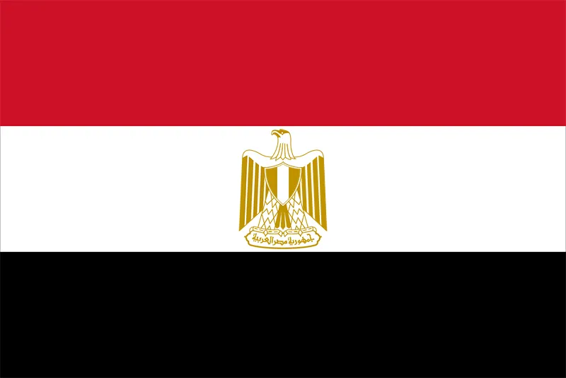
LET’S LEARN ABOUT EGYPT
Egypt
Cairo
Capital city _______
Language________
Draw the Egyptian flag here
Arabic

Slide 3

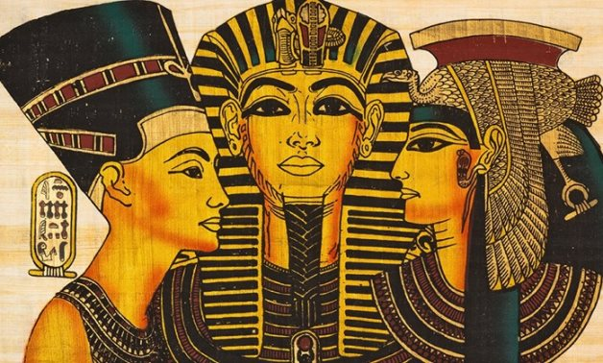
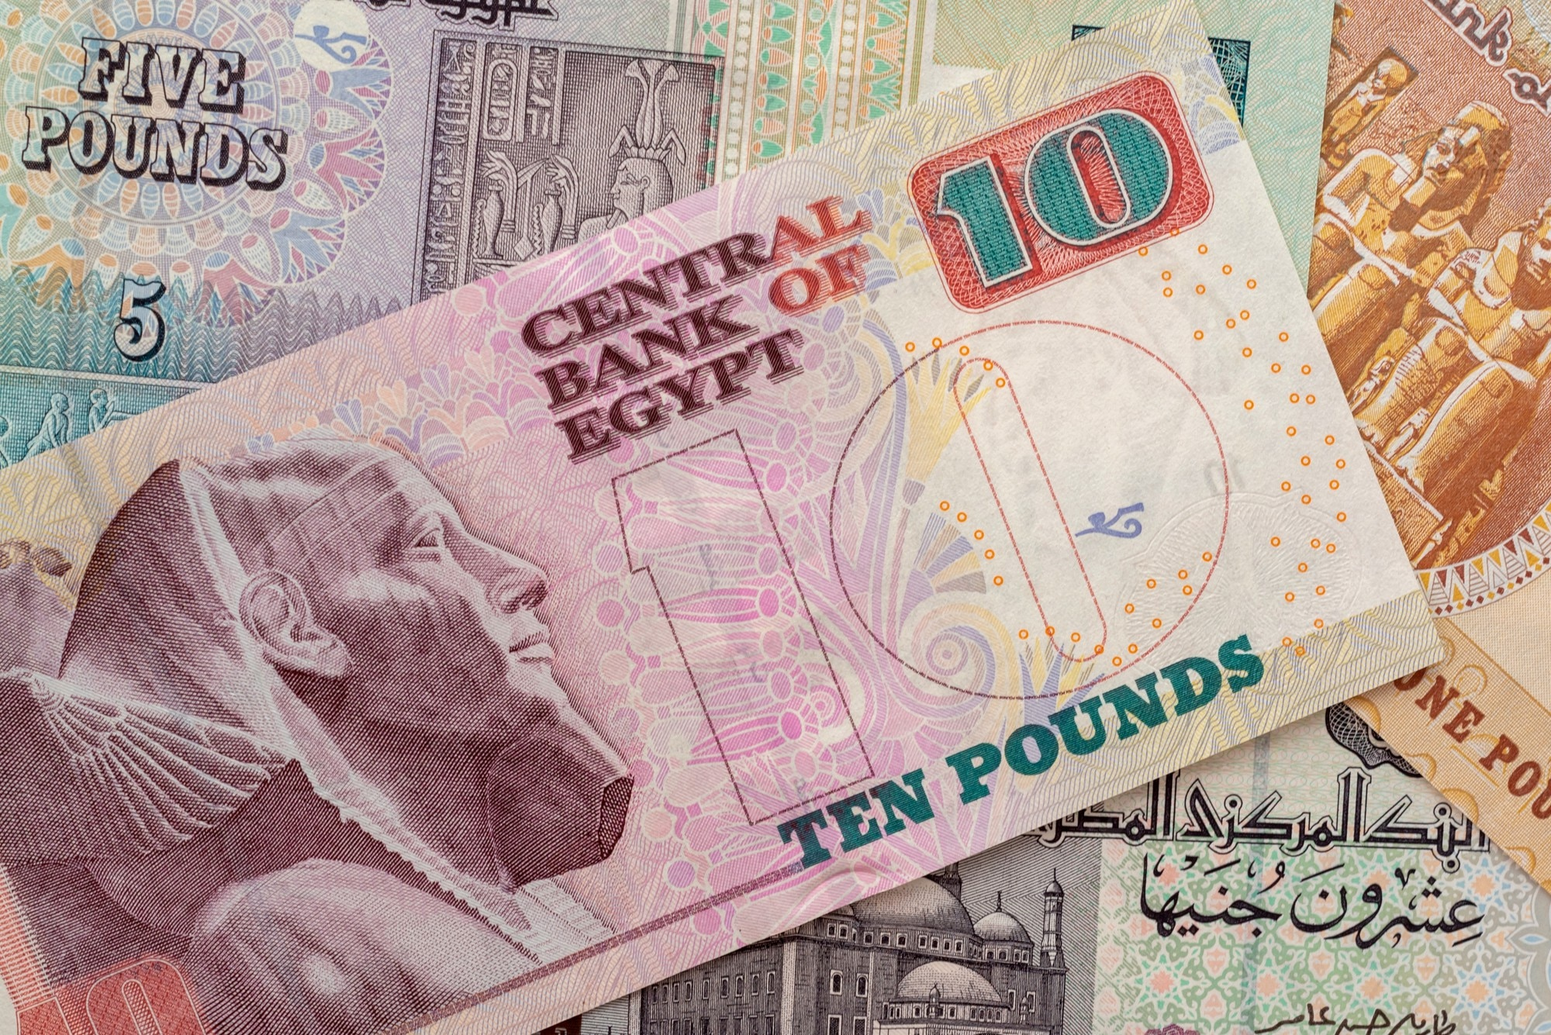
LET’S LEARN ABOUT EGYPT
Nile
The ________ is the l o n g e s t river in the world
Cut and paste Egyptian Pound here
An ancient Egyptian King was called a ____________
Pharaoh

Slide 4
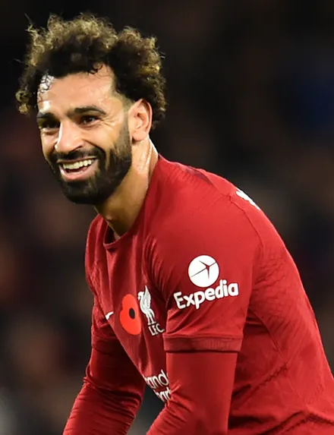
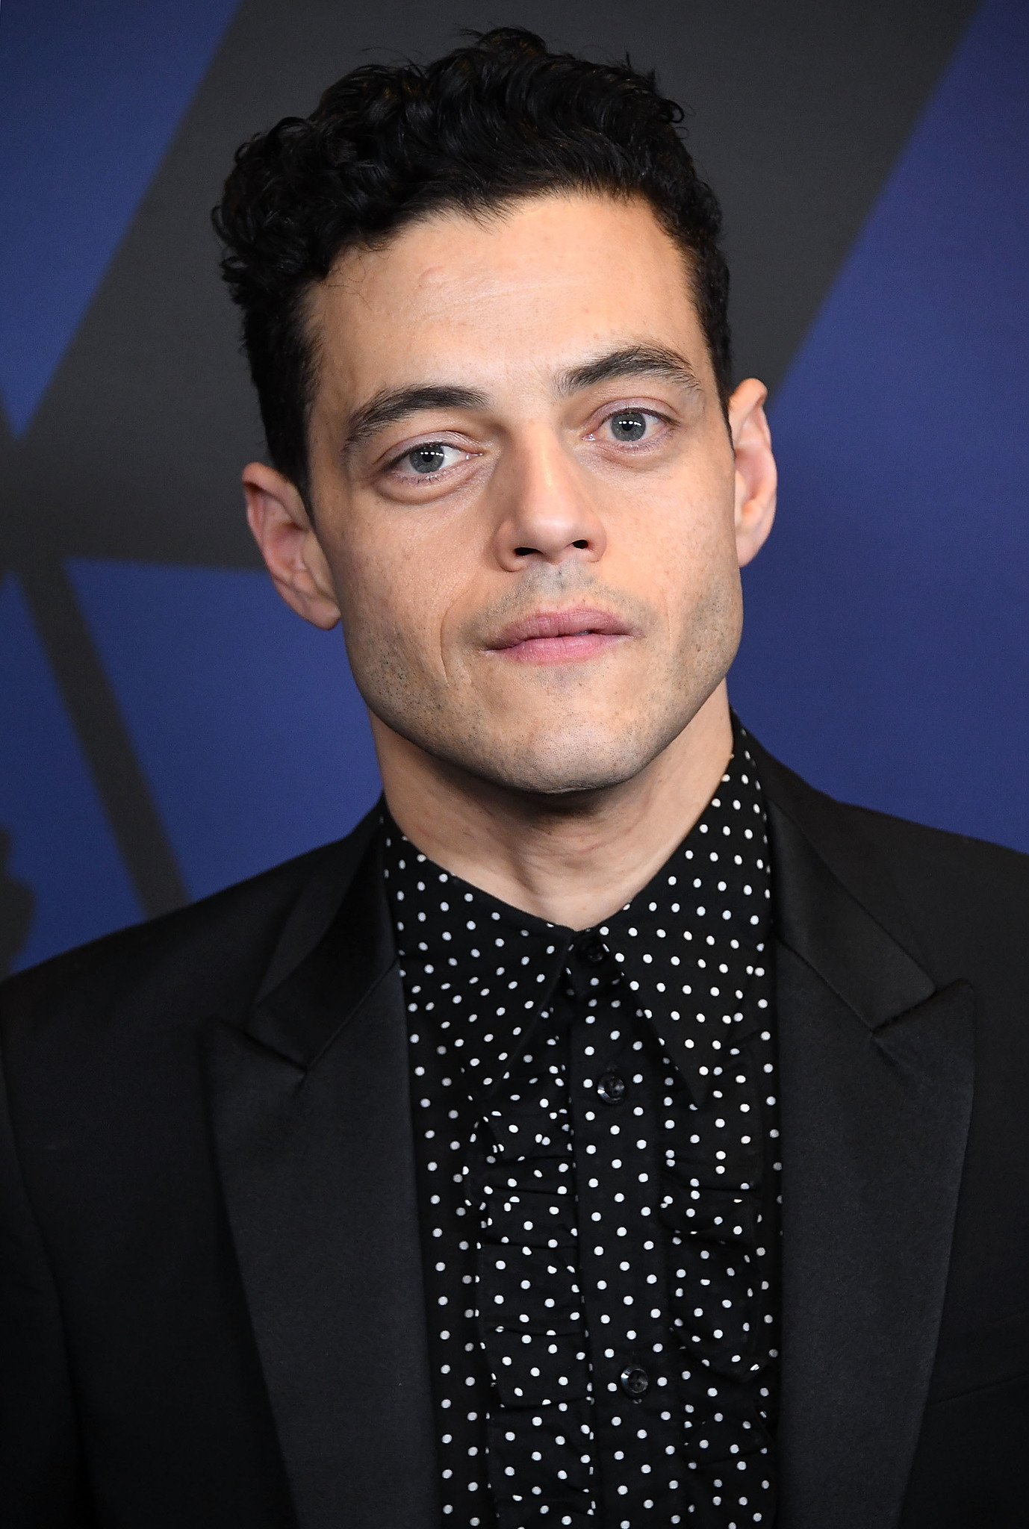
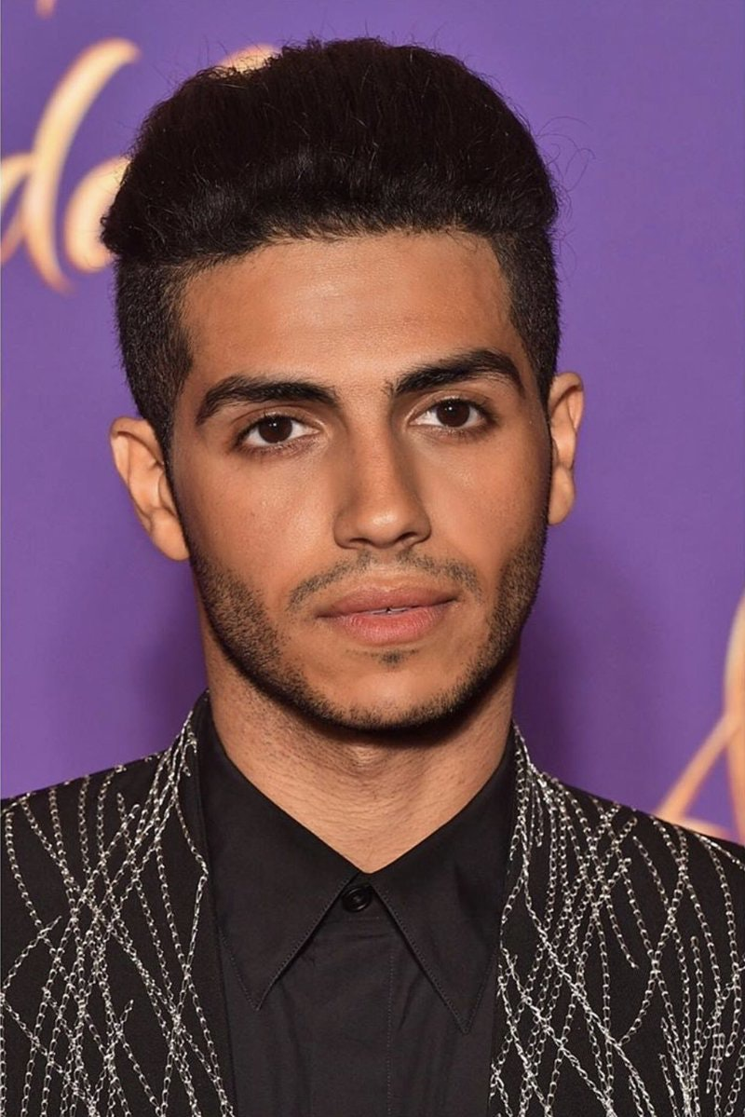
FAMOUS PEOPLE FROM EGYPT
I’m Mohamed Salah. I am a _________ for _________.
I’m Rami Malek. I am an _______.
I’m Mena Massoud. I am also an _______.
footballer
actor
actor
Liverpool

Slide 5
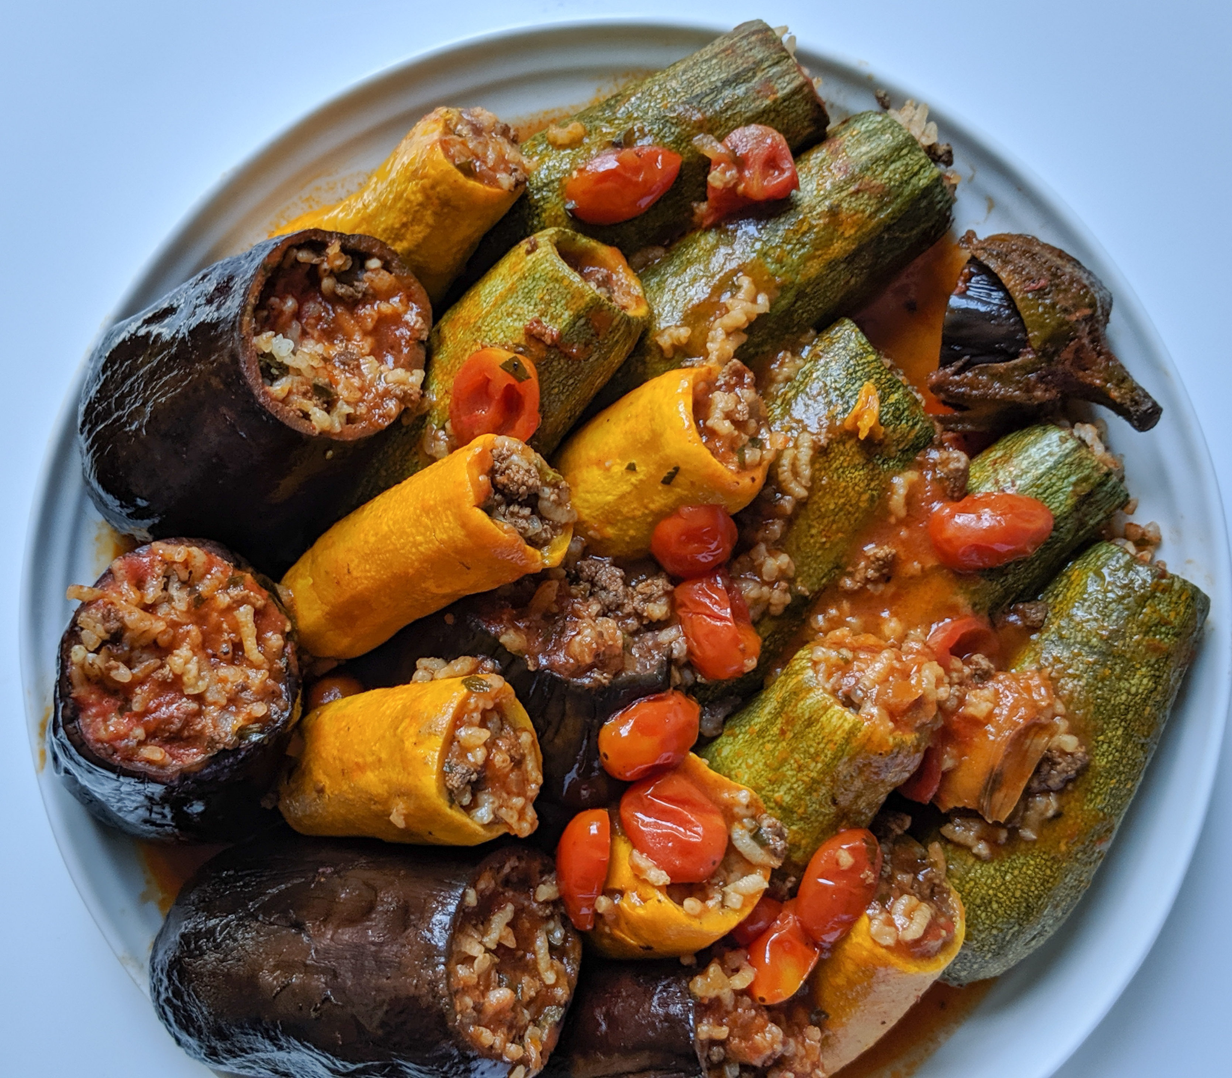
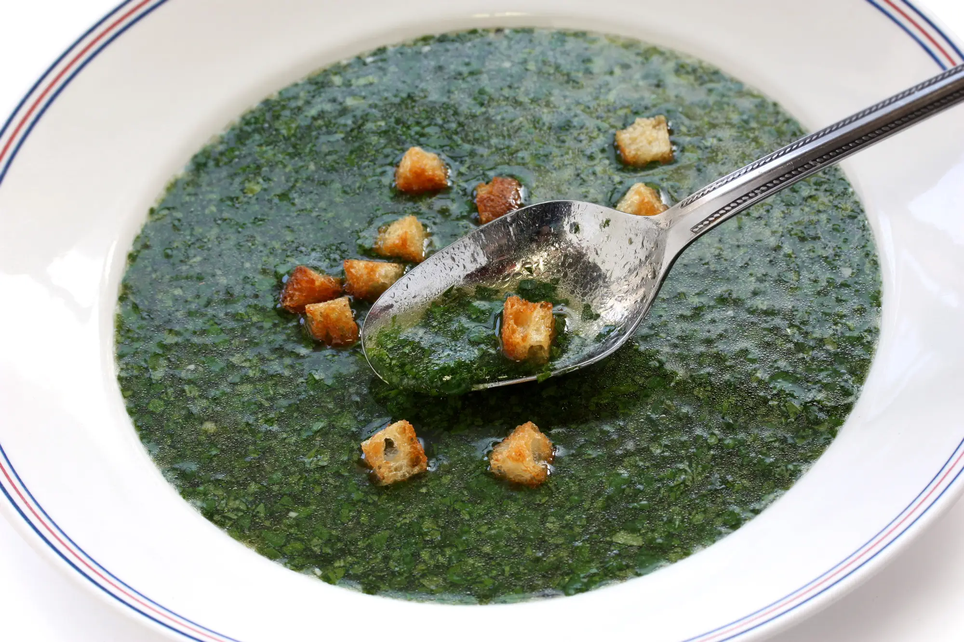
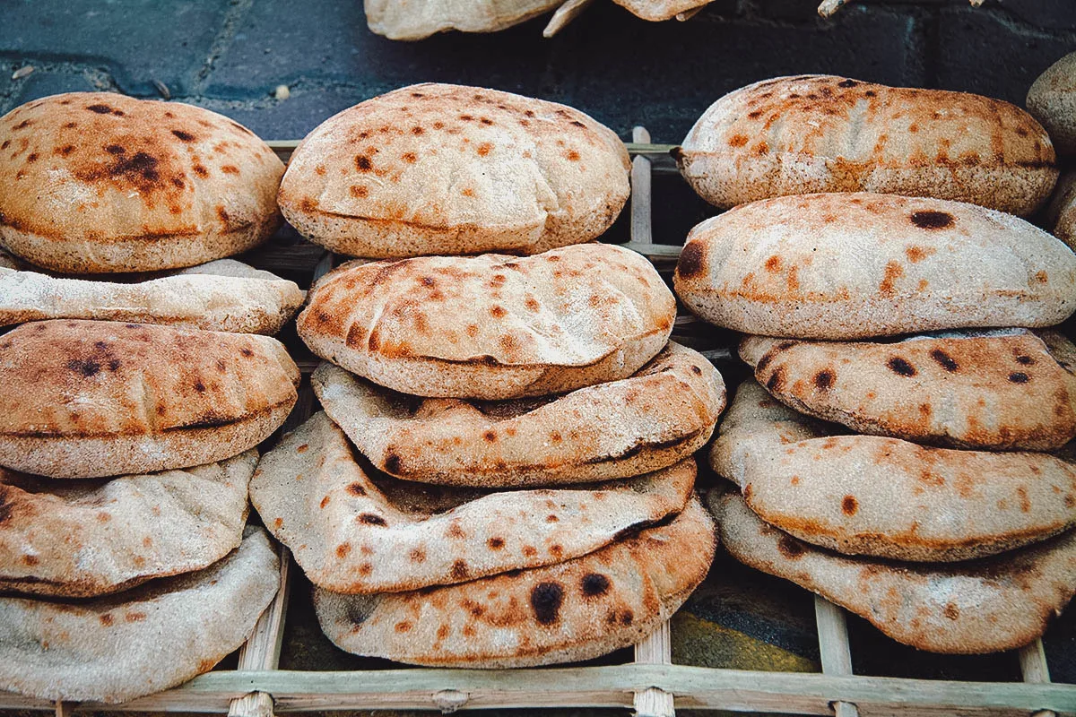
EGYPTIAN CULTURE AND FOOD
Molokhia
Mahashi
A soup made with leaves from the molokhia plant.
Stuffed vegetables
Aish baladi
Flatbread

Slide 6


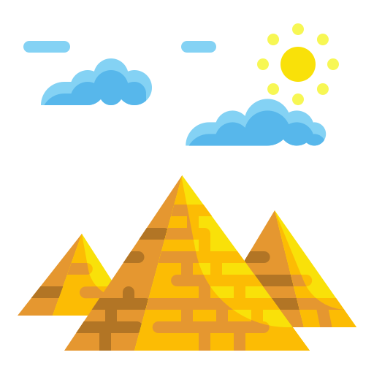
FUN FACTS ABOUT ANCIENT EGYPT
Cats
_____ were believed to be good luck!
Sphinx
The _________
was built to guard important buildings.
___________
pyramids have been found.
Around 118

Slide 7
HIEROGLYPHICS

Slide 8
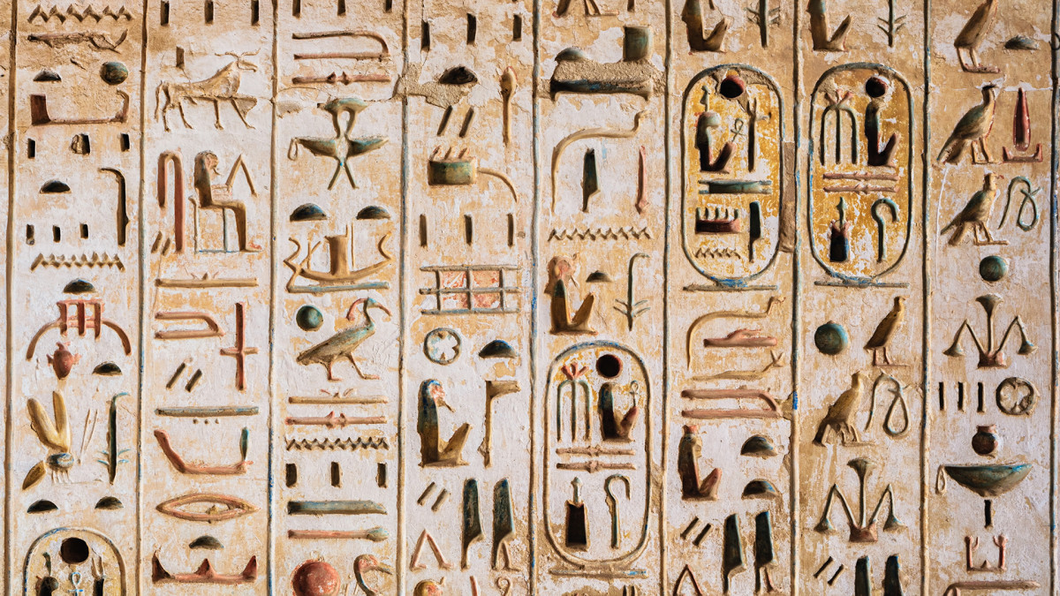
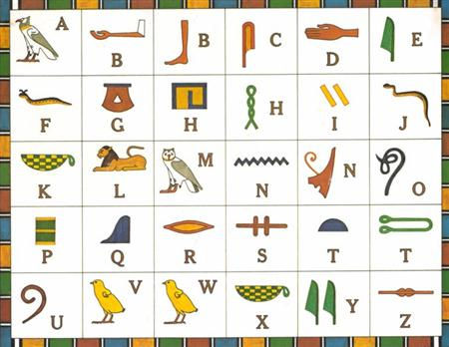
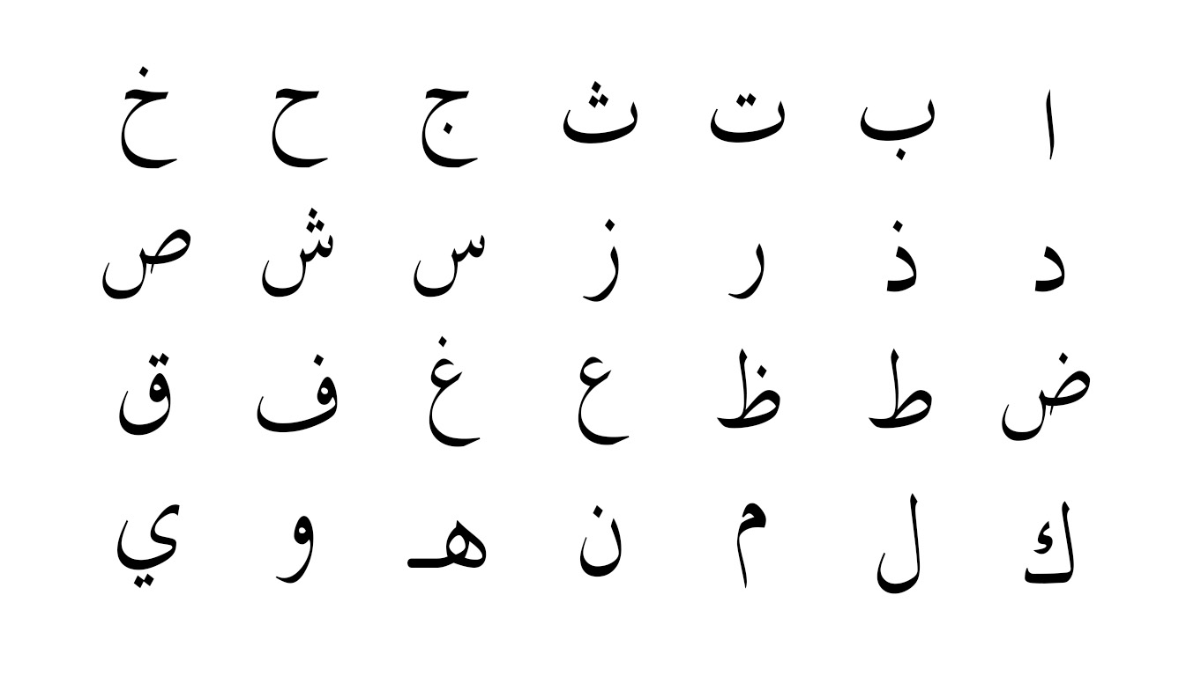
HIEROGLYPHICS
Before using the Arabic alphabet, Egyptians used hieroglyphics.

Slide 9
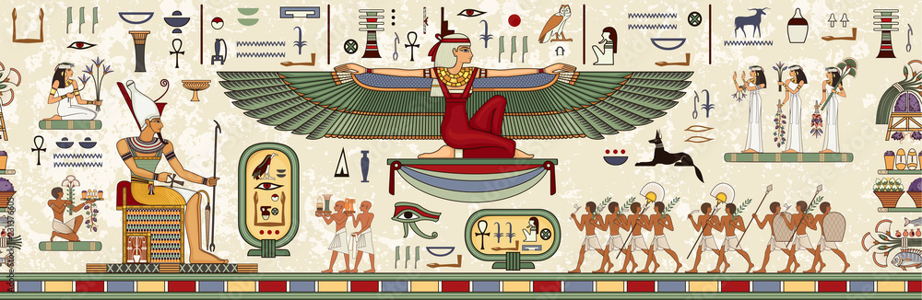
HIEROGLYPHICS
They used pictures instead of words. Some pictures were used for two English letters

Slide 10
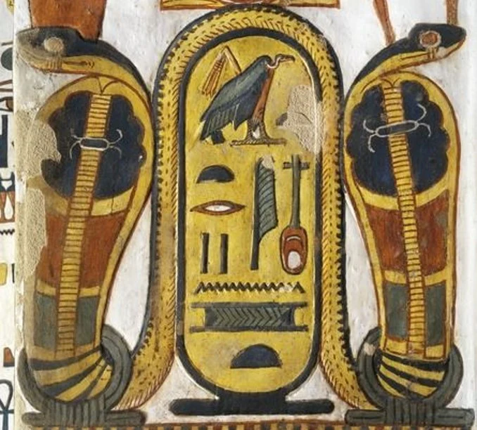
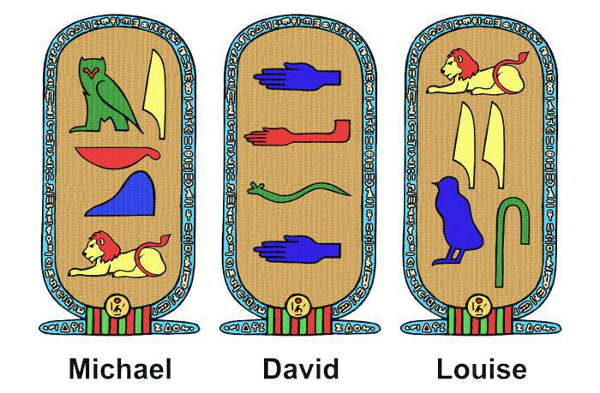
HIEROGLYPHICS
An Egyptian name tag is called a ‘cartouche’.

Slide 11

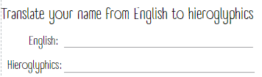
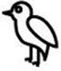

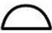


IN YOUR BOOK…
Write your name in English and in hieroglyphics
Practice your cartouche design
Agatha

Slide 12
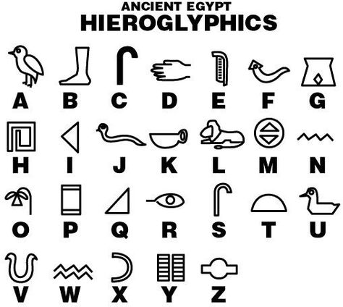

Slide 13
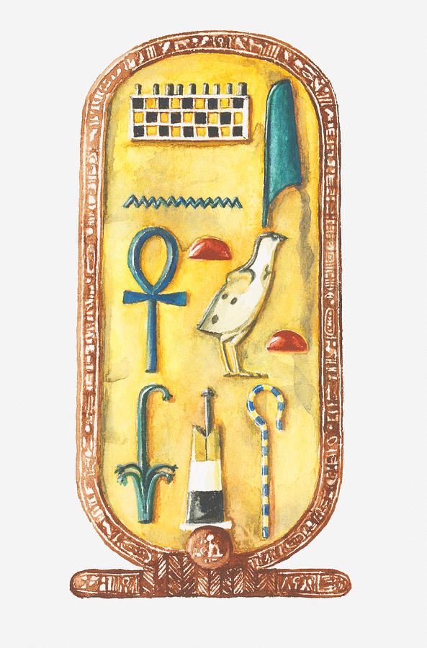
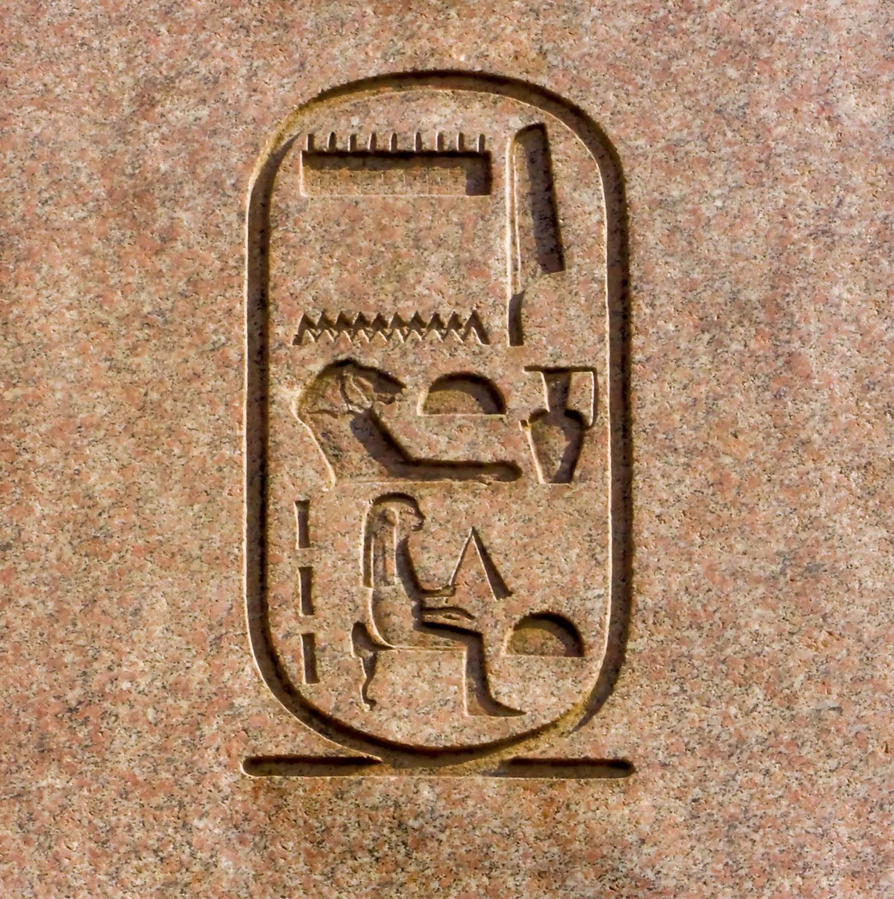
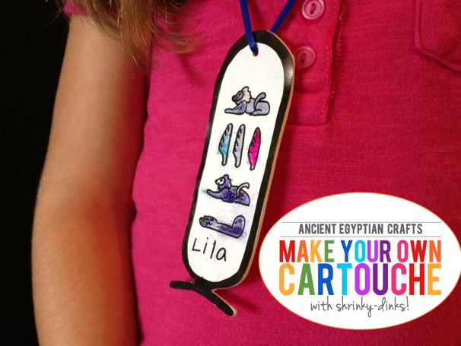
MAKE
YOUR OWN CARTOUCHE
Practice your design in you book
Agatha
REMEMBER!
Names were written from top to bottom

Slide 14
SECRET CODE (Cipher)
RACE

Slide 15
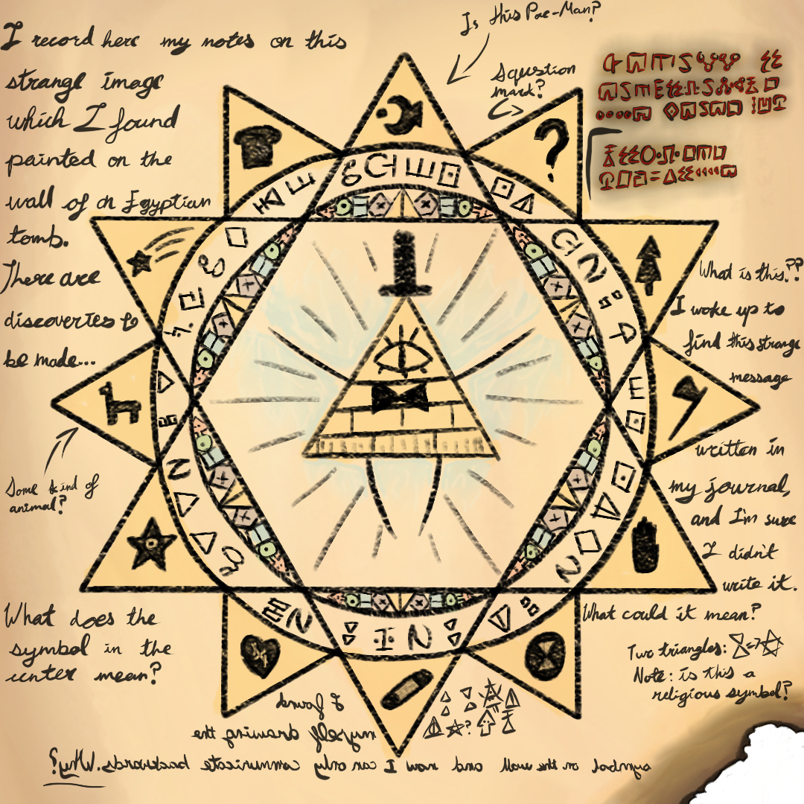
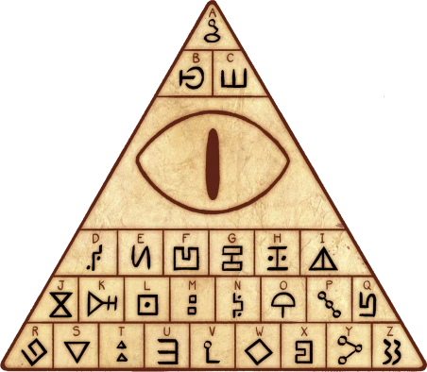
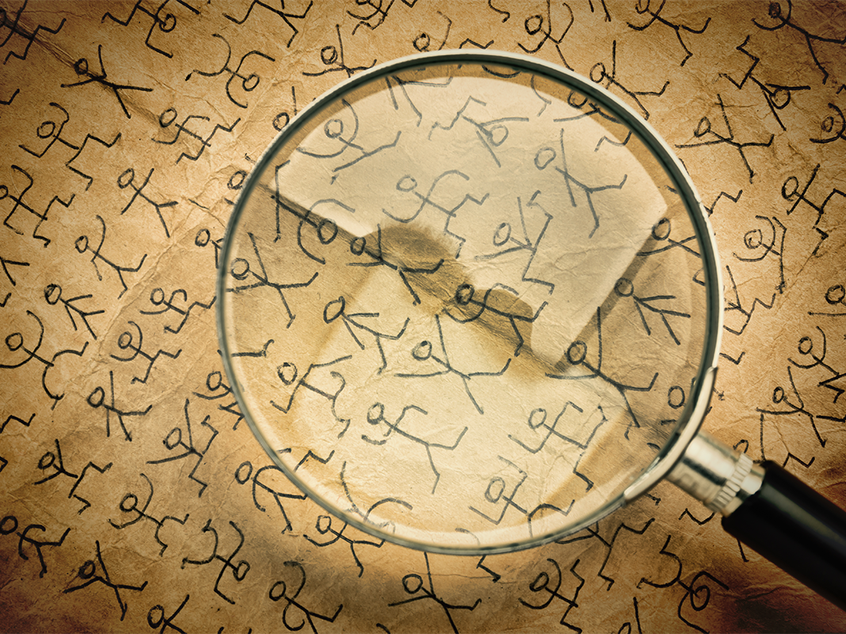
WHAT IS A CIPHER?
A cipher is a message written in a secret code.

Slide 16
Secret Code (Cipher) RACE
Translate the hieroglyphics into English
Notes:
Read the clue
Find the next clue
The clues are inside the school building
Only take YOUR team’s color clues
DON’T MOVE OTHER CLUES

Slide 17
JOURNAL WRITING

Slide 18
JOURNAL WRITING
Write a few sentences in English about your day
Draw a picture about your day
What did you like?
What did you not like?
Remember, full sentences
Good journals get extra points!

Slide 19
